Slide 1
Introduction to Machine Learning: logistic regression (classification)
Goldsmiths University

Slide 2
Summary
KNN no assumptions of the data, training happens at the time of prediction, we can choose numbers of K and distance metrics
Linear models assumes Linear relationship, no or little multicollinearity of features
So far we looked on how to evaluate a model by looking at the score value (and r2_score for regression)

Slide 3
Logistic Regression
Logistic Regression is commonly used to estimate the probability that an instance belongs to a particular class.
Example. The model predict probability of 0.25
If prediction is < 50% (0.5) then the class is 0
If prediction is > 50% (0.5) then the class is 1
0.25 is less than 0.5
Then y is 0

Slide 4
Example
regression
classification
100
grade
Pass or fail
1
0
0
Hours spent on studying for the exam
Hours spent on studying for the exam

Slide 5
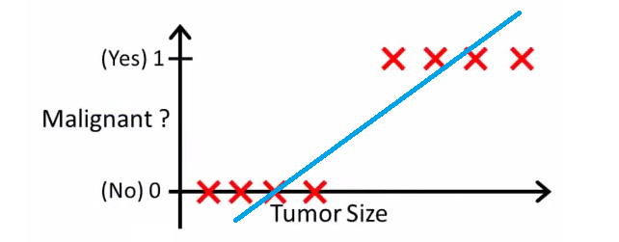
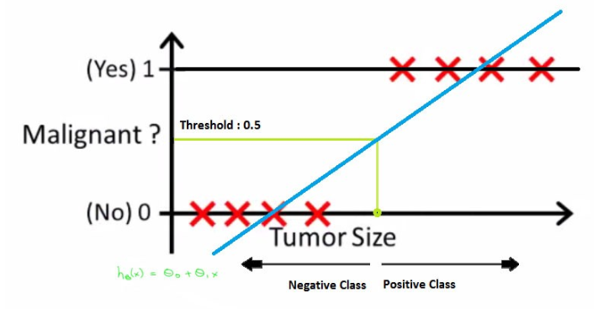
Logistic Regression
Try to use linear regression for classification
We threshold at 0.5 classification
Can you spot a problem here?

Slide 6
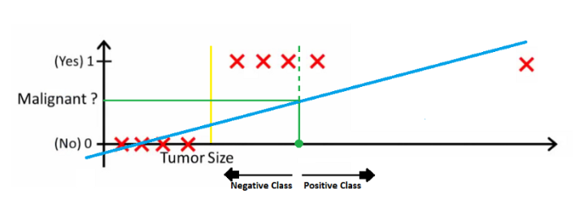
Logistic regression
Effect of one “Outlier”.
The green dotted line (Decision Boundary) is dividing malignant tumors from benign tumors but the line should have been at the yellow line which is clearly dividing the positive and negative examples. So just a single “good outlier” is disturbing the whole linear regression predictions.

Slide 7
Logistic regression
The question that we need to answer is:
What is the tumor size value when the probability of a Malignant tumor is higher than 50%?
We just want to know if it is higher than 50% to make our prediction.

Slide 8
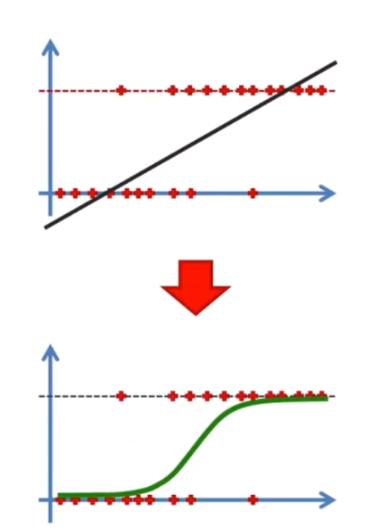


Logistic regression
We need a way to change this
We take the linear regression formula
Y
Into this:
And pass it through the Sigmoid function to get a probability
P
From Y
To P
( 0 to 1)

Slide 9
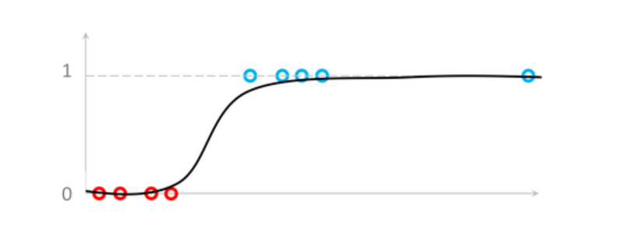
Logistic regression: predict probability & binary classification
e.g. we have a new data point corresponding to a specific tumor size
0.92
Is it malignant or not? (0 or 1)
P=0.92 > 0.5
So malignant
Tumor size
Logistic regression takes care of outliers
It helps us answer the question: What is the tumor size for a Malignant tumor probability of 0.5?
Or, what is the probability of a malignant(or not) for each tumor size?
What is the probability of this data point of being malignant tumor?
92% (very high)

Slide 10
Exercise
Logistic regression outputs a probability between 0 and 1 (eg. 0.25) of being in class 1
The threshold is 0.5 by default (we will see if it will make sense to change this in the exercise)
It is a binary classifier (but you can predict multiple classes as well using scikit-learn because it will run several binary classifiers one vs all (OVA). OVA is a competition of classifiers for each class to predict where the one with higher value win.)
In the exercises we will look at:
Categorical features
Stratifications
Evaluation of classification model
binarisation

Slide 11
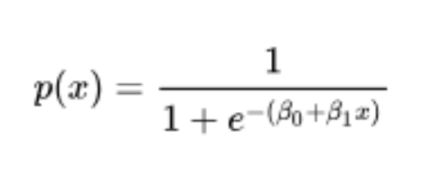
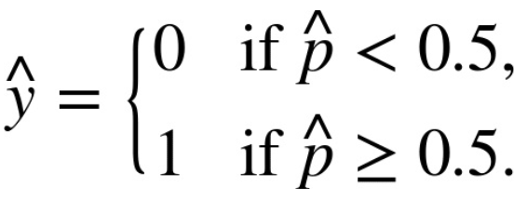
Summary
Just like a Linear Regression, a Logistic Regression model computes a
weighted sum of the input features (plus a bias term), but instead of outputting the result directly like the Linear Regression model, it outputs the logistic (the output of the sigmoid function) of this result.
The model needs to learn the optimal values for these weights.

Slide 12
Euler’s number, the constant e
e = 2.71828
(a constant)

Slide 13
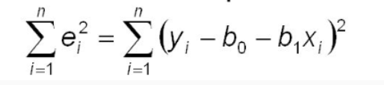
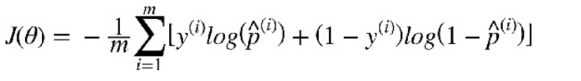
Bad and good news
This is the cost function for linear regression
This is the cost function for logistic regression
The bad news is that there is no known closed-form equation to compute the value of θ that minimizes this cost function (there is no equivalent of the Normal Equation). But the good news is that this cost function is convex, so Gradient Descent is guaranteed to find the global minimum.

Slide 14
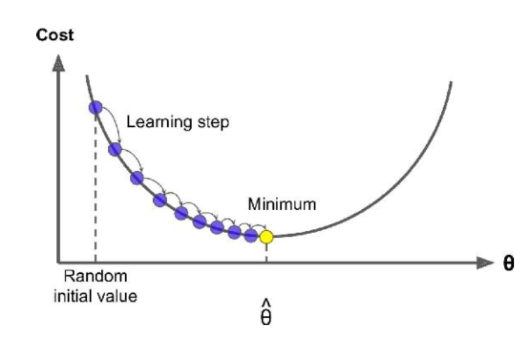
Gradient Descent
Slope is > 0
The general idea of gradient descent is to tweak the weights iteratively in order to minimize a cost function- (in this case the log loss)
it looks at the partial derivatives values for each feature
every iteration you take a step and and each step you are attempting to decrease the cost function until the algorithm converges to a minimum
Slope is < 0
- time - = +
- time + = -
The key point is that the gradient value in the update iteration is always subtracted from the previous update. So if the function is convex the update always push us toward the minimum.

Slide 15
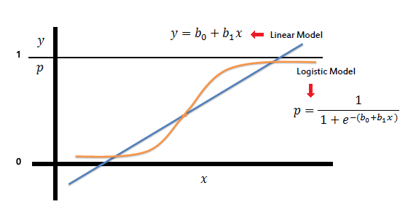
Extra: Logistic regression is a binary classifier
By Default Scikit learn apply OvA
There is also the option to use Softmax.

Slide 16
Extras: Cost function
We need to find the weights that minimise the cost function.
The cost that we want to minimize
Model’s predictions
True labels
If the true label is 0
If the true label is 1

Slide 17
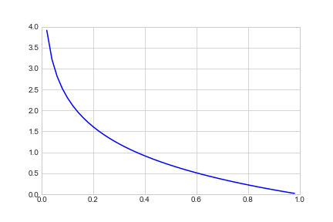
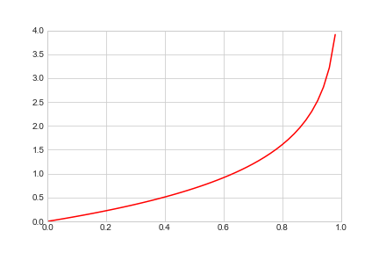
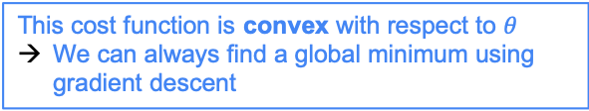


Cost function
If true label is 1 then the function is minimized with high value of p, if the true label is 0 then the function is minimized with low value of p. (since log(1) is 0)
$if y=1$:
$if y=0$:
This cost function is convex with respect to $θ$
We can always find a global minimum using gradient descent
If the true label is 0
If the true label is 1

Slide 18
Why we need to avoid collinearity
Linear models assumes Linear relationship, no or little multicollinearity of features
https://statisticsbyjim.com/regression/multicollinearity-in-regression-analysis/
The interpretation of a regression coefficient is that it represents the mean change in the dependent variable for each 1 unit change in an independent variable when you hold all of the other independent variables constant. The stronger the correlation, the more difficult it is to change one variable without changing another. It becomes difficult for the model to estimate the relationship between each independent variable and the dependent variable independently because the independent variables tend to change in unison. But sometimes correlations are good (we will see for instance x at the power of 2)

Slide 19
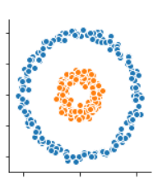
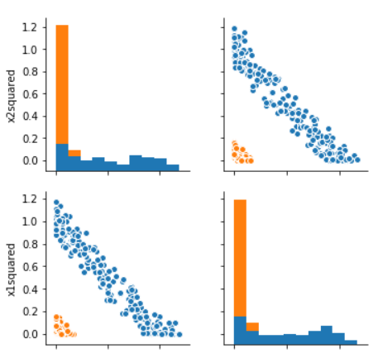
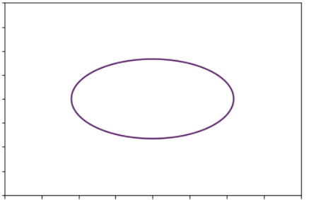
Example of feature engineering and polynomials- examples of good correlation of features
Y = w1 * x1 + w2 * x2 + bias
Y = w1 * x1^2 + w2 * x2^2 + bias
x2
x1
LM separates data with a line (hyperplane) but the polynomial can be a complex curve.
So overfit can occur.
Correlation can be a good thing. But it can make it hard to interpret the contribution of independent coeffs.
Can you draw a line that separate this two colors in a perfect way?
Linear regression uses y = slope*feature + bias
x1, x2 and target is the color
See also polynomial notebook

Slide 20
Polynomial
https://scikit-learn.org/stable/modules/generated/sklearn.preprocessing.PolynomialFeatures.html

Slide 21
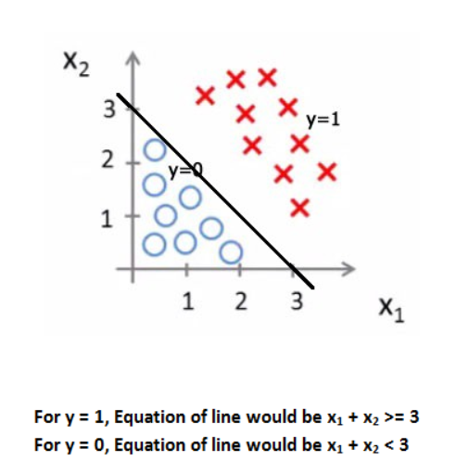
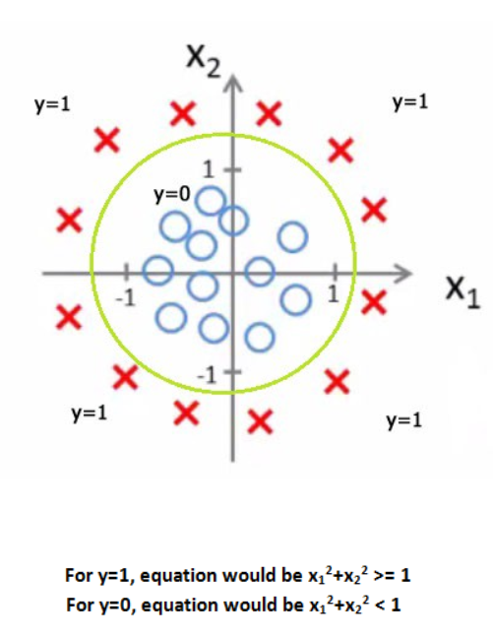
Decision Boundary : line where p = 0.5
Classes
y = 0
y = 1

Slide 22
Evaluation of binary classifiers: confusion matrix
TN
FP
FN
TP
A binary classifier has output: $Y→\{\text{non}\text{−}\text{dog},\text{dog}\}$
TP: True Positives – Correctly identified as dog
TN: True Negatives – Correctly identified as non-dog
FP: False Positives – Incorrectly identified as dog
FN: False Negatives – Incorrectly identified as non-dog

Slide 23
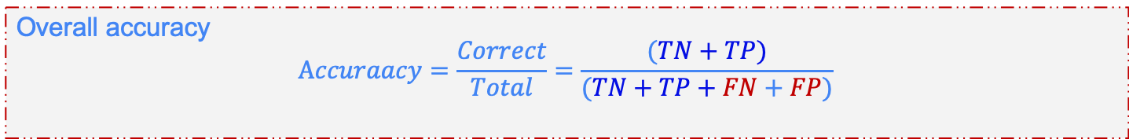
Evaluation of binary classifiers: confusion matrix
Overall accuracy
$$\text{A}ccuraacy=\frac{Correct}{Total}=\frac{(TN+TP)}{(TN+TP+FN+FP)}$$

Slide 24

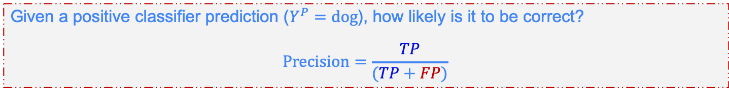
Evaluation of binary classifiers: confusion matrix
cv
Given a positive example ($Y^{GT}=\text{dog}$), how likely will the classifier will accept it?
$$\text{Recall}=\frac{TP}{(TP+FN)}$$
Given a positive classifier prediction ($Y^{P}=\text{dog}$), how likely is it to be correct?
$$\text{Precision}=\frac{TP}{(TP+FP)}$$

Slide 25
Extra: Feature scaling

Slide 26
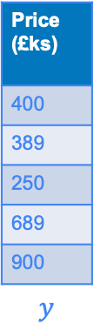




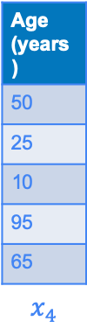

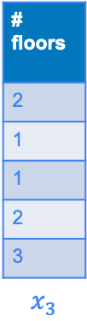

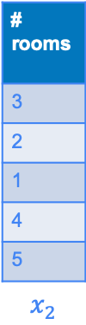
Feature scaling
Area ($m^{2}$)
100
60
40
150
300
$$x_{1}$$
# rooms
3
2
1
4
5
$$x_{2}$$
# floors
2
1
1
2
3
$$x_{3}$$
Age (years)
50
25
10
95
65
$$x_{4}$$
Price (£ks)
400
389
250
689
900
$$y$$
Multiple explanatory variables
All on different scales, e.g.
area range($x_{1}$) = (0-1000 $m^{2}$)
# rooms range($x_{2}$) = (1-5)
Scale the features
Avoids unnecessarily large or small $θ$
Gradient descent converges faster
mean, ${\overline{x}}_{j}=\frac{1}{m}\sum_{i=1}^{m}{x_{j}^{\left(i\right)}}$
Range normalization
Centre data around mean:
Min-max normalization (0 and 1):
Standardisation (z-score)
Ensure data has mean = 0 and standard deviation = 1:
$$x_{j}^{s}=\frac{x_{j}−{\overline{x}}_{j}}{max\left(x_{j}\right)−\min\left(x_{j}\right)}$$
$$x_{j}^{s}=\frac{x_{j}−\min\left(x_{j}\right)}{max\left(x_{j}\right)−\min\left(x_{j}\right)}$$
$$x_{j}^{s}=\frac{x_{j}−{\overline{x}}_{j}}{std\left(x_{j}\right)}$$

Slide 27

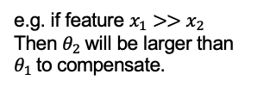




Feature scaling: effect on regression parameters
Gradient Descent using unscaled data
$$θ_{1}$$
$$J(θ_{0},θ_{1})$$
$$θ_{2}$$
e.g. if feature $x_{1}>>x_{2}$
Then $θ_{2}$ will be larger than $θ_{1}$to compensate.
Gradient Descent using scaled data
$$θ_{1}$$
Converges faster!
$$θ_{2}$$

Slide 28
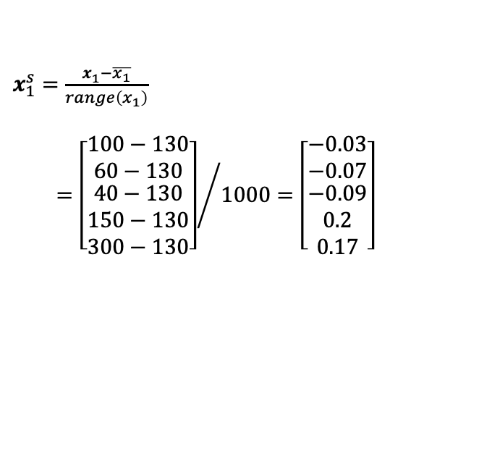
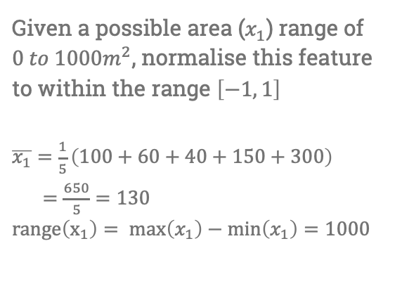

Feature scaling: example
Area ($m^{2}$)
100
60
40
150
300
$$x_{1}$$
# rooms
3
2
1
4
5
$$x_{2}$$
# floors
2
1
1
2
3
$$x_{3}$$
Age (years)
50
25
10
95
65
$$x_{4}$$
Price (£ks)
400
389
250
689
900
$$y$$
Given a possible area ($x_{1}$) range of ${0 to 1000m}^{2}$, normalise this feature to within the range $\left[−1, 1\right]$
$\overline{x_{1}}=\frac{1}{5}\left(100+60+40+150+300\right)$
$=\frac{650}{5}=130$
$range\left(x_{1}\right)= \max\left(x_{1}\right)−\min\left(x_{1}\right)=1000$
-0.03
-0.07
-0.09
0.2
0.17
$$x_{1}^{s}$$
$x_{1}^{s}=\frac{x_{1}^{ }−\overline{x_{1}}}{range\left(x_{1}\right)}$
$={\left[\begin{matrix}100−130 \\ 60−130 \\ \begin{aligned}40−130 \\ 150−130 \\ 300−130\end{aligned}\end{matrix}\right]}/{1000}=\left[\begin{matrix}−0.03 \\ −0.07 \\ \begin{aligned}−0.09 \\ 0.2 \\ 0.17\end{aligned}\end{matrix}\right]$

Slide 29


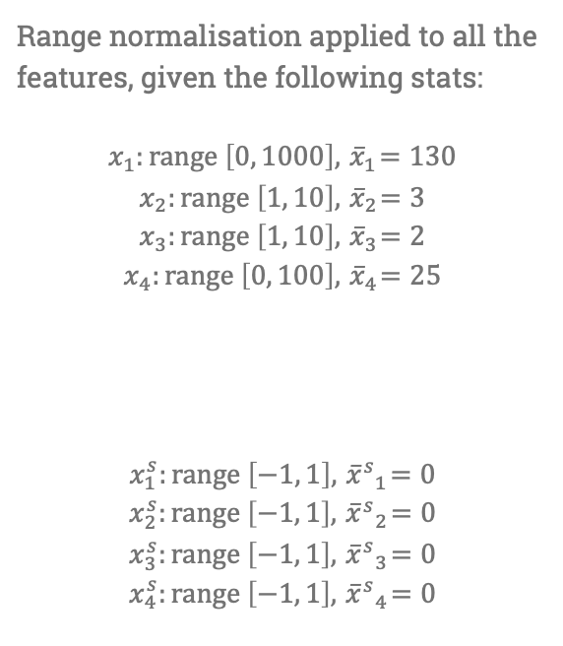
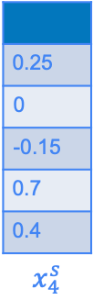
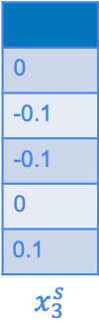
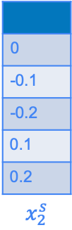
Feature scaling: example
Area ($m^{2}$)
100
60
40
150
300
$$x_{1}$$
# rooms
3
2
1
4
5
$$x_{2}$$
# floors
2
1
1
2
3
$$x_{3}$$
Age (years)
50
25
10
95
65
$$x_{4}$$
Price (£ks)
400
389
250
689
900
$$y$$
Range normalisation applied to all the features, given the following stats:
$$x_{1}:range \left[0, 1000\right], { \overline{x}}_{1}=130$$
$$x_{2}:range \left[1, 10\right], { \overline{x}}_{2}=3$$
$$x_{3}:range \left[1, 10\right], { \overline{x}}_{3}=2$$
$$x_{4}:range \left[0, 100\right], { \overline{x}}_{4}=25$$
$$x_{1}^{s}:range \left[−1, 1\right], { {\overline{x}}^{s}}_{1}=0$$
$$x_{2}^{s}:range \left[−1, 1\right], { {\overline{x}}^{s}}_{2}=0$$
$$x_{3}^{s}:range \left[−1, 1\right], { {\overline{x}}^{s}}_{3}=0$$
$$x_{4}^{s}:range \left[−1, 1\right], { {\overline{x}}^{s}}_{4}=0$$
$$x_{j}^{s}=\frac{x_{j}^{ }−\overline{x_{j}}}{range\left(x_{j}\right)}$$
-0.03
-0.07
-0.09
0.2
0.17
$$x_{1}^{s}$$
0
-0.1
-0.2
0.1
0.2
$$x_{2}^{s}$$
0
-0.1
-0.1
0
0.1
$$x_{3}^{s}$$
0.25
0
-0.15
0.7
0.4
$$x_{4}^{s}$$

